Slide 1
Notes:
Welcome at Barco
Maybe unknowingly, you’ve met some Barco products before, be it in a Hospital, in a corporate meeting setting, in a Museum or in any other entertainment or Cinema setting.
So allow me to introduce our full company to you!

Slide 2
We enable bright outcomes by transforming content into insight and emotion
Notes:
Barco did a rebranding exercise in 2017, which resulted in the following mission: “We enable bright outcomes by transforming content into insight and emotion”
It means that in a world where data and rich content are expanding, Barco provides its customers with solutions that help them make meaningful connections.
Like helping radiologists read medical images faster and more accurately, which will lead to a better diagnosis and then a targeted treatment.
Or help a control room operator gain a perfect overview of air traffic, so that they can act instantly when something happens.
In cinemas, Barco helps create unique movie experiences.
That’s how we enable bright outcomes: we help our customers to achieve amazing results.

Slide 3
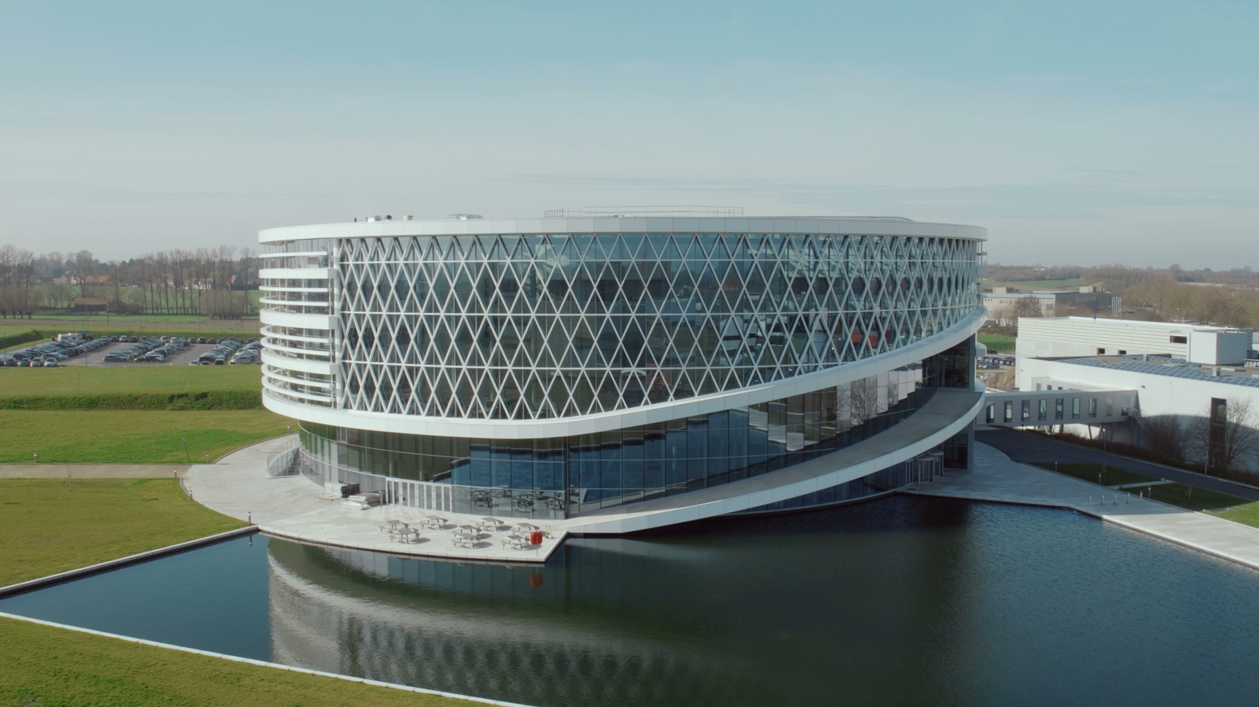
Let’s look what
Barco is all about.
Notes:
Let’s get started with our company movie that will explain you what we’re all about.

Slide 4
ABOUT US
Barco was founded in 1934 in Belgium
We are global technology leader that develops networked visualization solutions for the entertainment, enterprise and healthcare markets.
Our solutions help people to enjoy compelling entertainment experiences; they foster knowledge sharing and smart decision-making in organizations and help hospitals provide their patients with the best possible healthcare.
Entertainment Theme parks, Museum, Cinema,Virtual Experience Venues & Hospitality
Enterprise Control rooms Meeting rooms
Healthcare Diagnostic imaging Surgical imaging
Notes:
I hope you enjoyed our movie, let’s do a quick recap:
Barco develops audio visual solutions for a variety of markets.
We offer them through our entertainment, healthcare and enterprise division.
Each of these consists of sub markets:
Entertainment: Cinema, venues and hospitality and professional AV, simulation
Healthcare: Diagnostic and surgical displays and OEM business
Enterprise: Meeting, learning, operator and virtual experience.
<Extra>
A still from the flagship laser trailer for Cinema
Eurosong
A diagnostic display for radiologists
A surgical display for the operating room
Control room operator workspace
Wireless collaboration in meeting rooms

Slide 5
BARCO GLOBAL PRESENCE
Barco Headquarter- Belgium Barco Middle East- Dubai
Training and Experience Centre

Slide 6
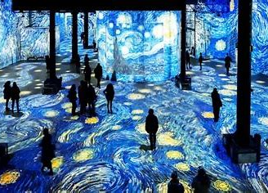
ENTERTAINMENT : CASE STUDIES
Theater :
La Perle in Dubai
Projection Mapping :
King Abdul-Aziz Center in KSA
Museum :
Infinty Art in Dubai
5
Theme Parks
Projection Mapping : QIDDIYA in KSA
Notes:
You will find Barco at impactful events that impress you with sights you have never seen before:
World Expo
Mega concerts of famous artists
Olympic games

Slide 7
BROADCAST STUDIO
Sky News Arabia in Dubai
Sky News and Sky Sports News HQ in UK
6
Korean TV in Korea Republic
MBC Al Arabiya in Dubai

Slide 8
CONTROL ROOMS : CASE STUDIES
Aramco, KSA
Schneider SEC Jeddah KSA
Holy Mecca Jeddah KSA
10
Dubai Civil Defence
Renfe Mercancías in Spain

Slide 9
HEALTHCARE : CASE STUDIES
Kakogawa Medical Center in Japan
Barco medical displays enable accurate diagnoses at radprax in
Germany
12
Royal Wolverhampton Hospital NHS in UK
Coronis Uniti® fuels teleradiology center of excellence in USA

Slide 10
ENABLING BRIGHT OUTCOMES...
13

